Slide 1
MLL phase contrast
Simple forward propagation

Slide 2
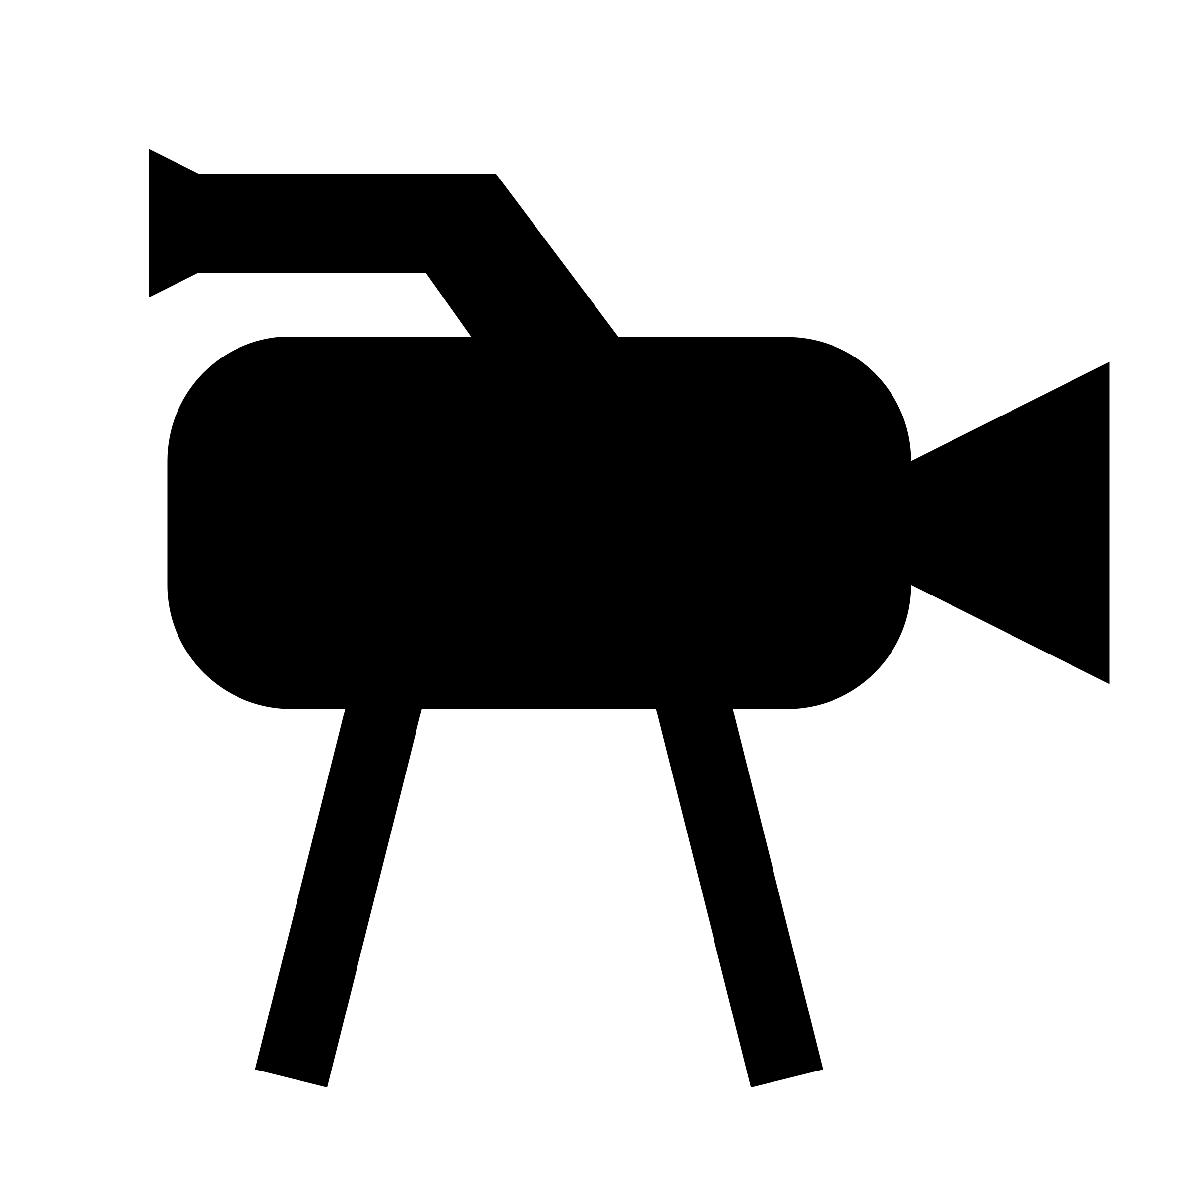
Simulation setup
Horizontal focus, 37.2 µm aperture
Vertical focus, 43.5 µm aperture
1.4 mm smaller than physical distance, thus avoiding astigmatism in the simulation (making analysis easier)
10.1 mm
3.3 mm
630 mm

Slide 3
Simulation parameters
Assuming perfect focus on the setup in last slide
Focal lengths
H: 9.45 mm 9.9 mm
V: 13.98 mm 13.1 mm
Magnification
H: 64.6 61.4
V: 43.1 46.0
These values are very close to the actual magnification, within a few percent

Slide 4
Simulation details
Sampling
Using double field of view (vs detector)
Using half pixel size (vs detector)
In total 8192x8192 pixels
Detector image obtained by binning 2x2 and reducing FOV by x2
MLLs
Assuming simple 1D lenses with perfect phase
Aperture applied
Misc
Perfect coherence assumed

Slide 5

Simulation image
200
400
600
800
1000
1200
1400
1600
1800
2000
500
1000
1500
2000

Slide 6
Data set
Using series Set4_2D_17.3keV
Using scan pco_focus_30s
Bright field, full field images
During this scan the lenses were moved together along the optical axis
Steps of 0.1 mm
41 images

Slide 7
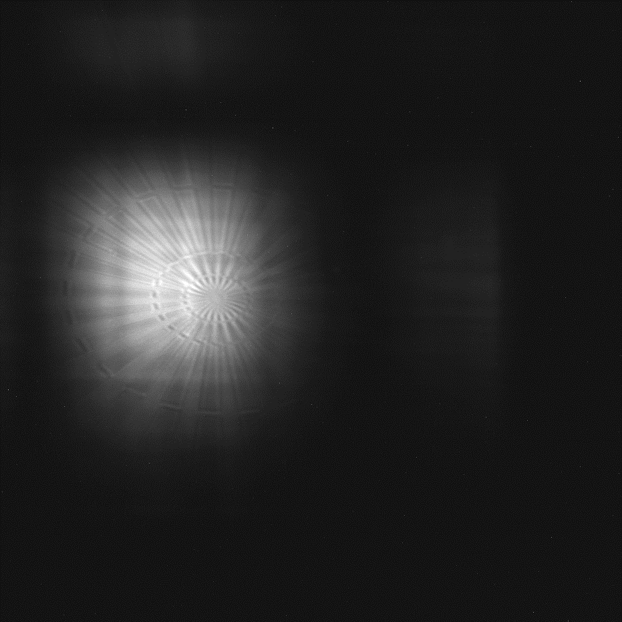
Data “issues”
1200
200
FOV motion during scan
400
1000
600
800
800
1000
600
1200
1400
400
Star motion during scan
1600
200
1800
2000
0
500
1000
1500
2000

Slide 8
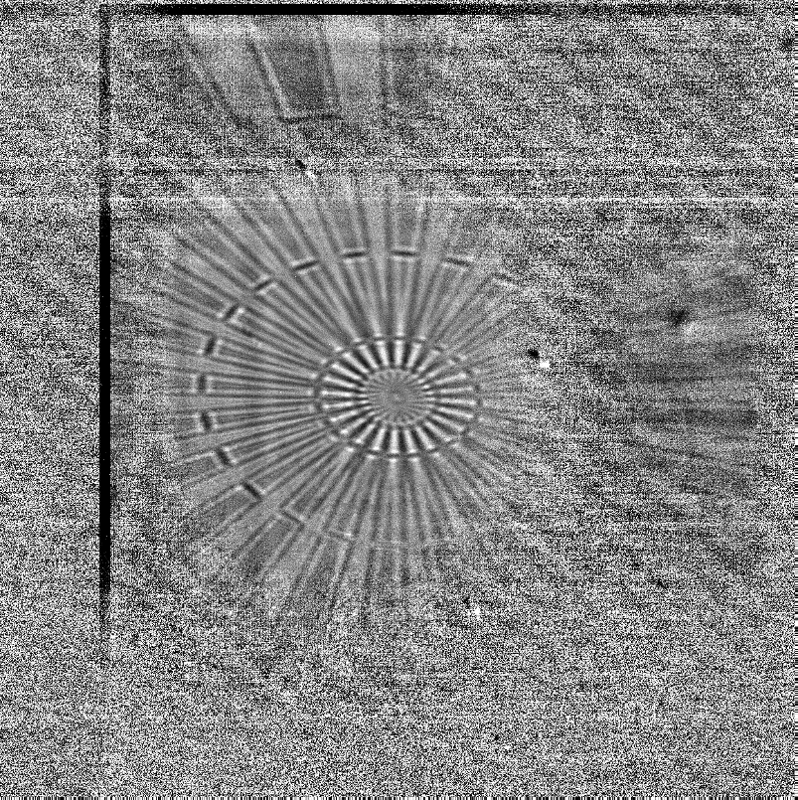
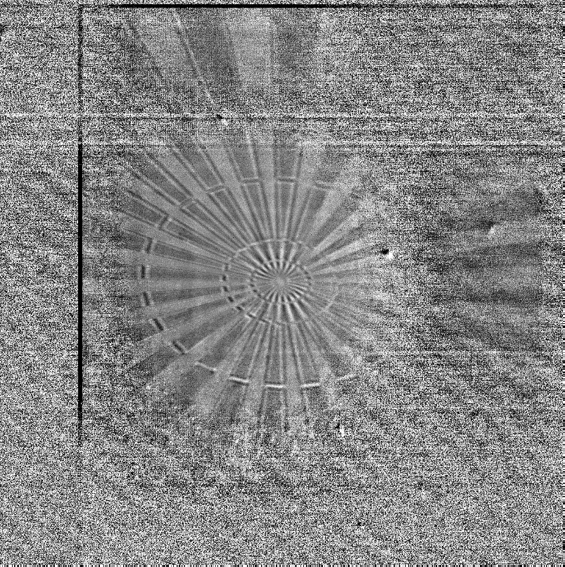
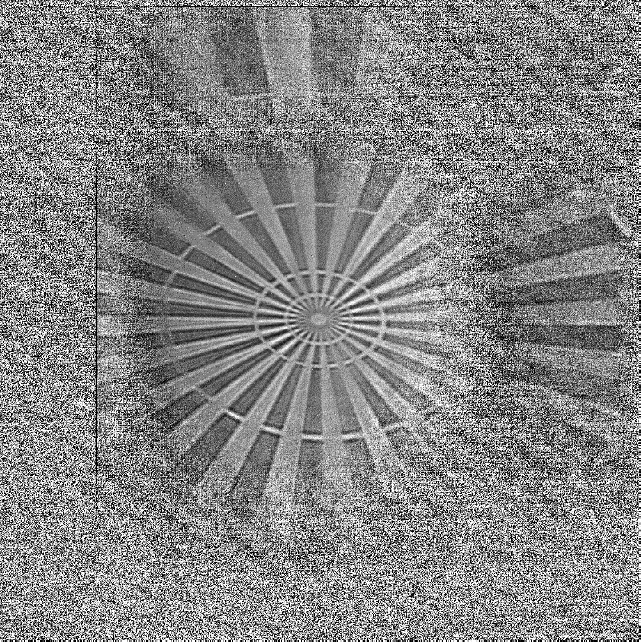
Corrected data
200
200
200
400
400
400
600
600
600
800
800
800
1000
1000
1000
1200
1200
1200
1400
1400
1400
1600
1600
1600
1800
1800
1800
2000
2000
2000
500
1000
1500
2000
500
1000
1500
2000
500
1000
1500
2000

Slide 9
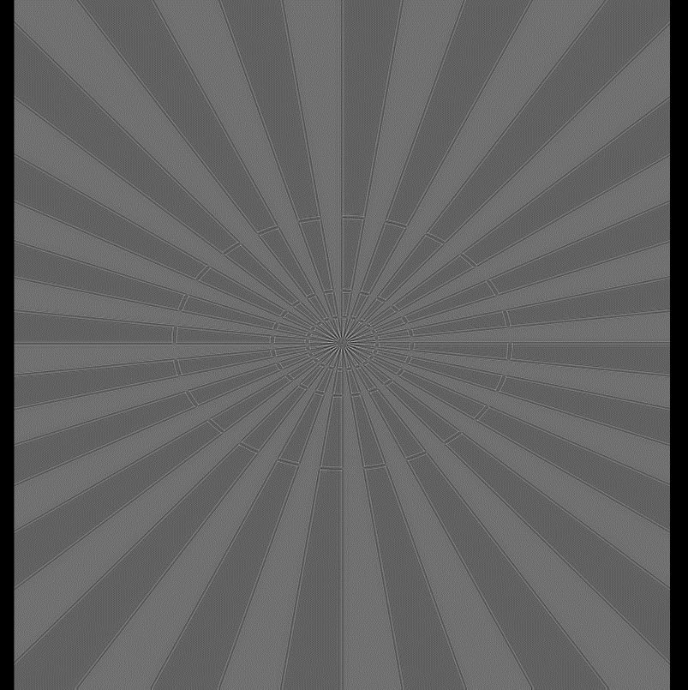
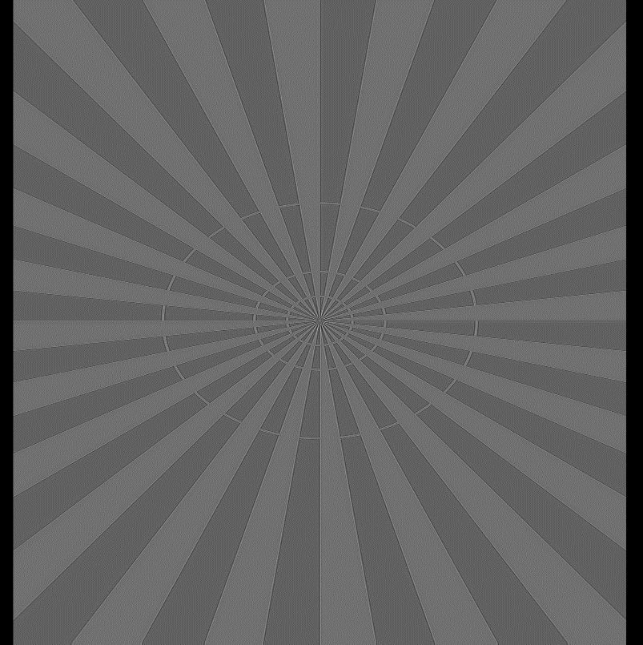
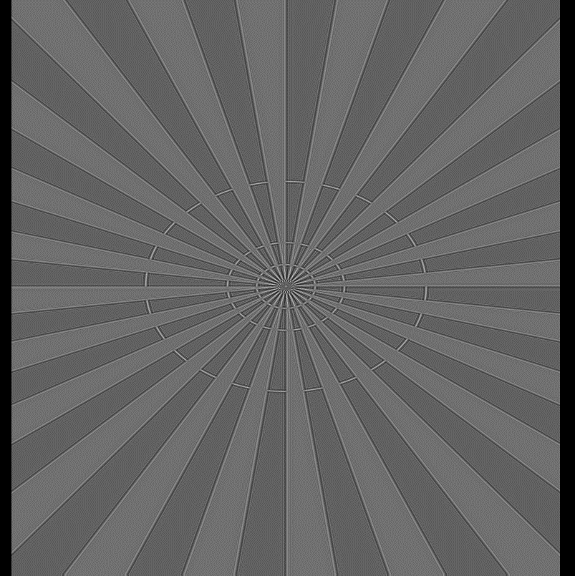
Simulated data
Simulation of a series of images moving both lenses in steps of 0.1 mm along optical axis
200
200
200
400
400
400
600
600
600
800
800
800
1000
1000
1000
1200
1200
1200
1400
1400
1400
1600
1600
1600
1800
1800
1800
2000
2000
2000
500
1000
1500
2000
500
1000
1500
2000
500
1000
1500
2000

Slide 10

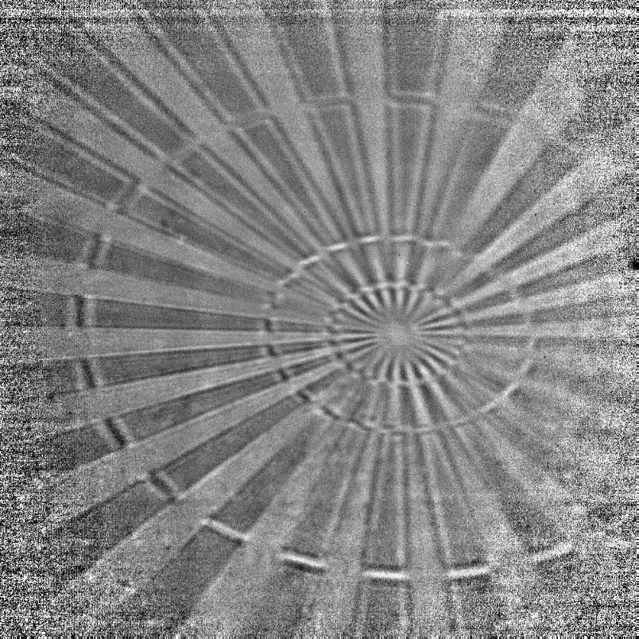
Line profiles (averaging ROIs)
For the measurement the pixels were shifted to make the edges perfectly vertical/horizontal
100
Top ROI, 50x100 pixels, averaged vertically
100
200
200
300
300
400
400
500
Left ROI, 100x50 pixels, averaged horizontally
500
600
600
700
700
800
Bottom ROI, 50x100 pixels, averaged vertically
800
900
900
1000
1000
200
400
600
800
1000
200
400
600
800
1000

Slide 11
Line profiles
Top
Left
Bottom
0.9
0.9
0.9
0.6
0.6
0.6
0.3
0.3
0.3
]
]
]
m
m
m
m
m
m
[
[
[
0
0
0
-0.3
-0.3
-0.3
-0.6
-0.6
-0.6
-0.9
-0.9
-0.9
-10
0
10
-10
0
10
-10
0
10
x [
m]
x [
m]
x [
m]

Slide 12
Line profile analysis
The simulation overestimates the amplitude of the fringes
In this simulation I used the correct thickness of the Au of 600 nm (before I used 100 nm)
The position and sign of the change is well reproduced by the simulation
The line profiles from the LEFT ROI show more oscillations, presumably due to a longer coherence length in the vertical direction

Slide 13
Line profile fitting (resolution estimate)
The fitted width of the step is highly sensitive to the focus point: lens too close to object gives wider step and lens too far from object gives sharper step. The resolution values are RMS widths of an assumed Gaussian point spread function.

Slide 14
Outlook
Updated values for the magnification and focal lengths
The simulation gives a good qualitative description of the measurements
The discrepancy is most likely due to limited coherence length in the experiment
Getting a good estimate of the resolution requires more sophisticated analysis
Although from the TOP and BOTTOM ROIs with weaker fringes the RMS resolution is more accurate, and gives a horizontal resolution in the range 30-40 nm

